Slide 1
ATTENDANCE ANALYZER TEAM CODE: CSEB6
VISHESH 2021
PROJECT EXPO

Slide 2
Understanding the problems
Overview
Project objective
Target audience

Slide 3
Understanding the problems
Errors due to manual work
Conservation of data
Requirement of manpower

Slide 4
Overview
Attendance Analyzer is a simple Python GUI (Graphical User Interface) based project .
We seek to provide a valuable attendance service for teachers.

Slide 5
Project objective
Attendance Analyzer is software developed for daily student attendance in schools, colleges and institutes.
It facilitates to access the attendance information of a particular student in a particular class.

Slide 6



Target audience
Schools
Colleges
Coaching Institutions

Slide 7

Introducing:
Attendance Analyzer
Making your daily task of taking attendance easier
Compatible on every operating system

Slide 8
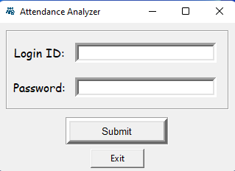

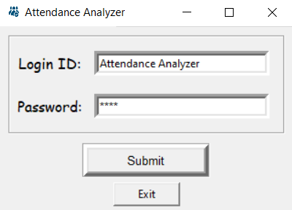

Enter Details
Login Page

Slide 9

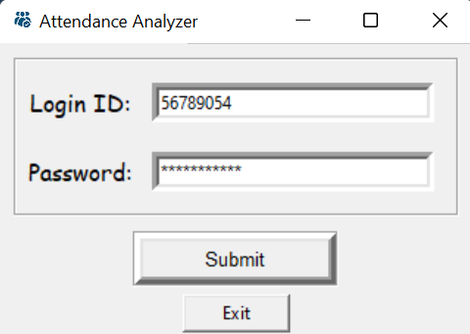
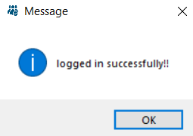

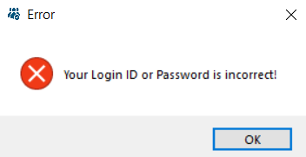
Login Error
Login successful

Slide 10
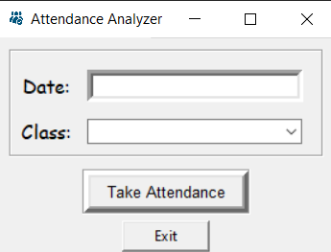
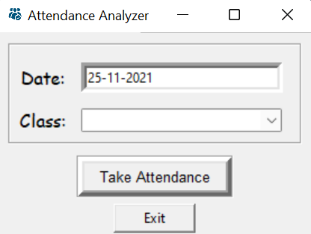
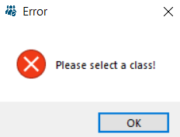
Choose a Class
Enter :-
Date
Class

Slide 11
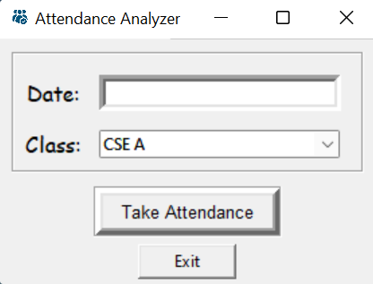

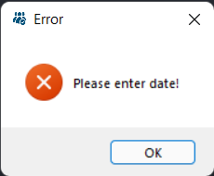
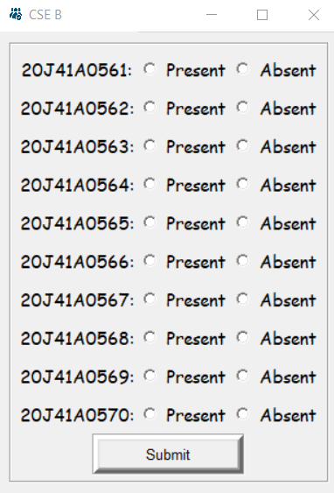
Roll numbers displayed
Enter the date

Slide 12
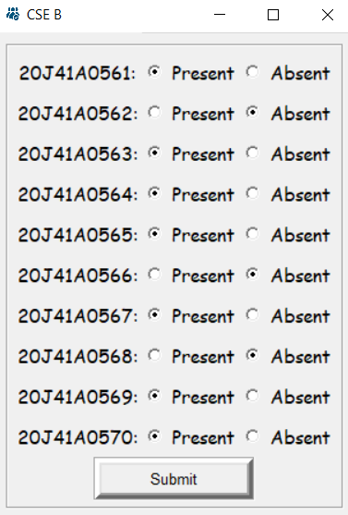
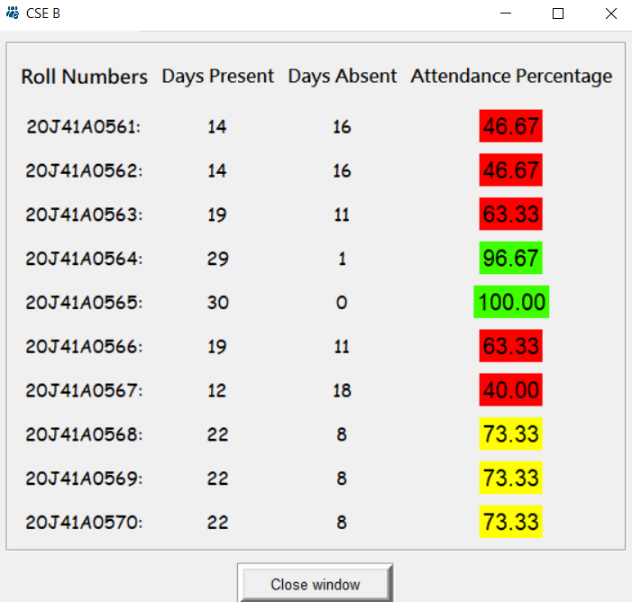
Attendance Record Displayed
Select
Present
Absent

Slide 13
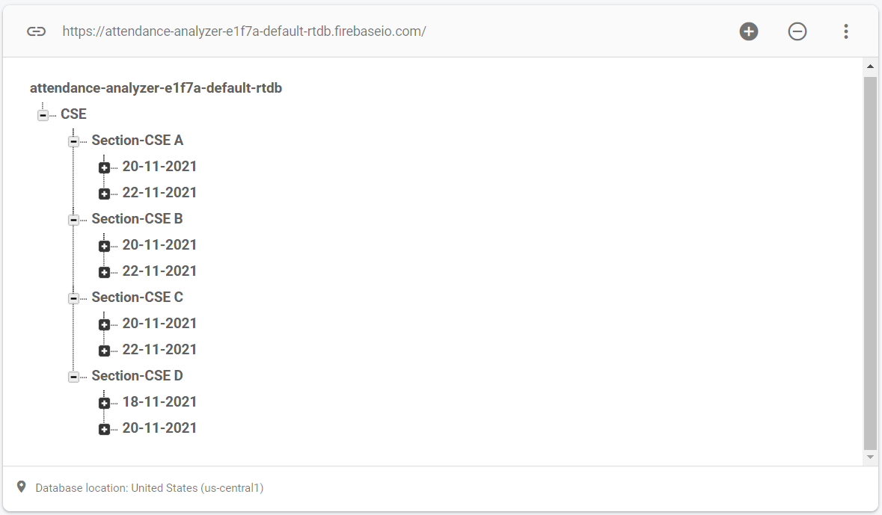
DATABASE (CLOUD STORAGE)
Safest form of data storage.
Easily accessible anytime from anywhere.

Slide 14
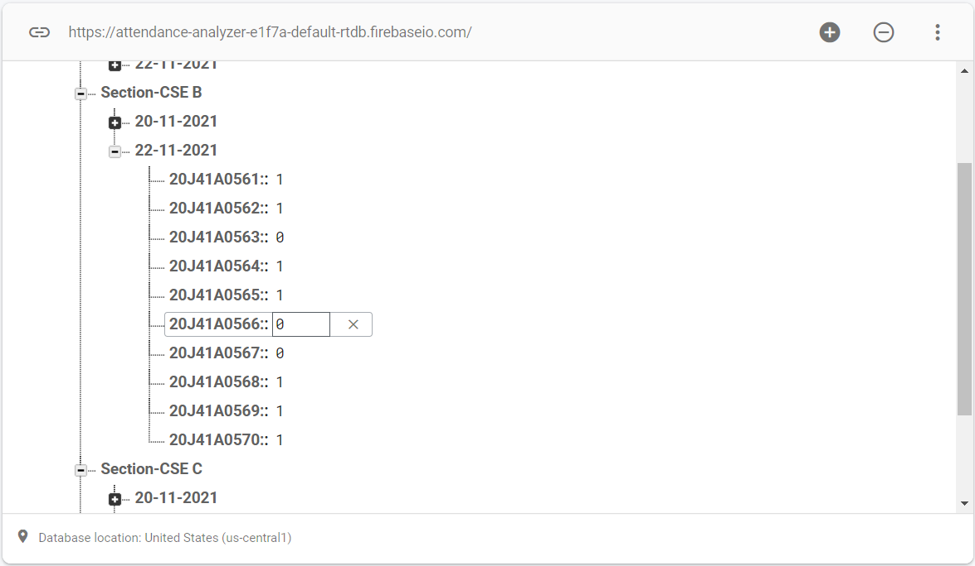
Stores data individually for each:
Branch
Section
Roll number
Only authorized person can access the data.
No manipulation of data.

Slide 15

THANK YOU
TEAM MEMBERS:
AMAN KUMAR SINGH
ARSHAD M.PATEL
DEV H.TRIVEDI
P.VAMSI KRISHNA
RAJ KISHOR

